Slide 1
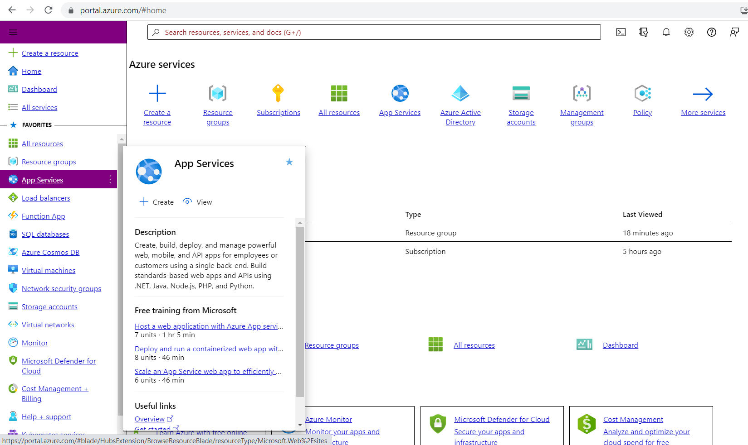
Tour to Azure Portal
1) Favorites:
This will be present in left hand side.
The most used resources can be set here to access them easily.
We can add or remove the favorites of the resources.

Slide 2
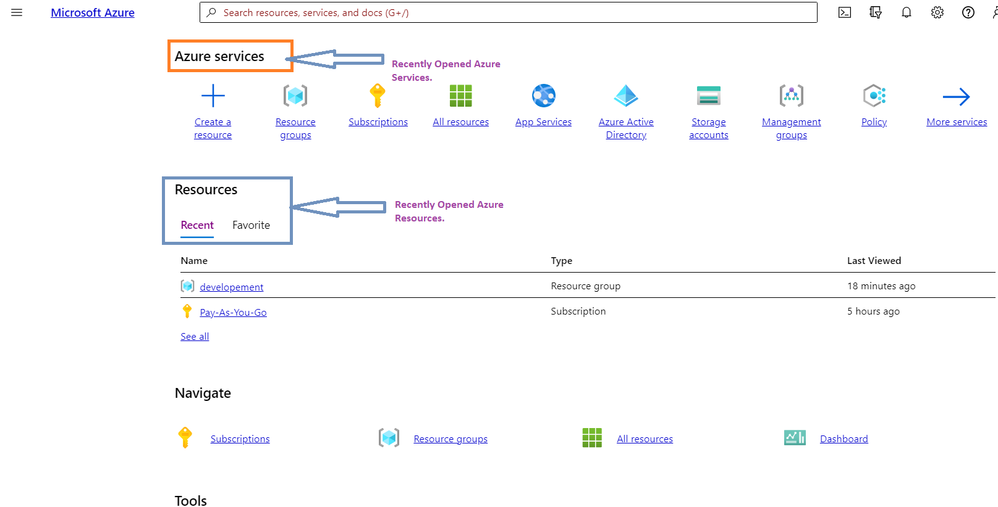
2) Azure Services and Recent:
These are the cache information of recently opened services and resources respectively.

Slide 3
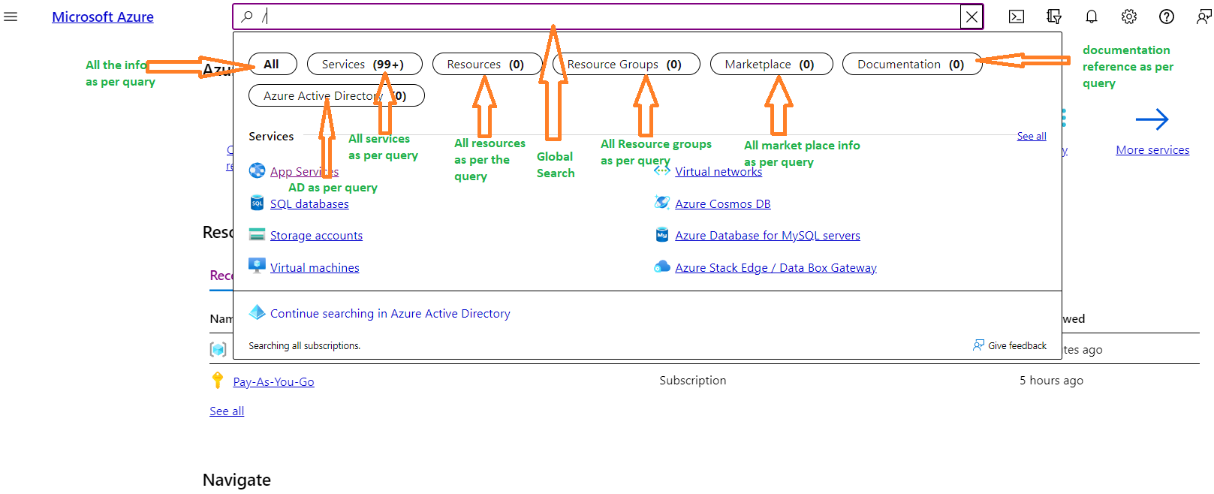
Global Search:
Search in the Azure portal just got better. You can jump to your resources, resource groups, and subscriptions no matter what you have open by using the global search box in the top bar.
Type a few characters of the name of what you're looking for, and you'll get a list of the resources, resource groups, and subscriptions that match your query.

Slide 4
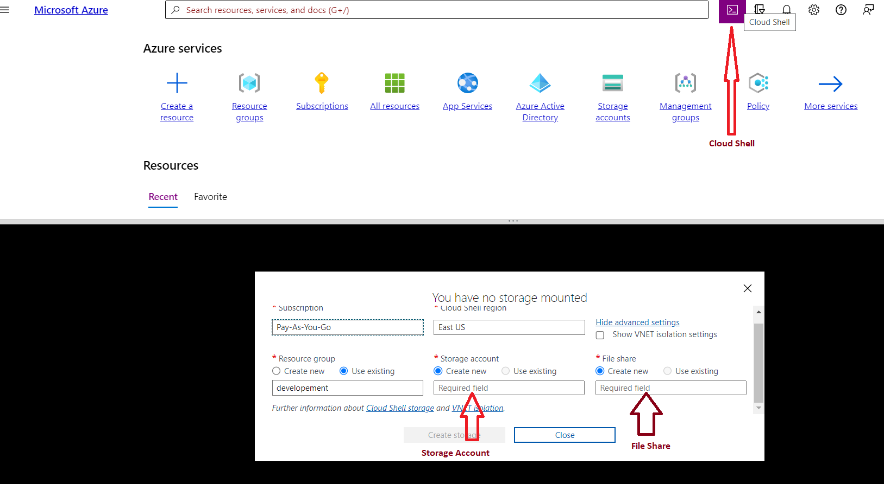
Cloud Shell:
We use cloud Shell for executing the commands on the cloud virtually without installing any software.
We need a storage Account and file share for accessing the Cloud shell.
We can execute shell, PowerShell commands, Kubectl, helm, Docker etc.

Slide 5
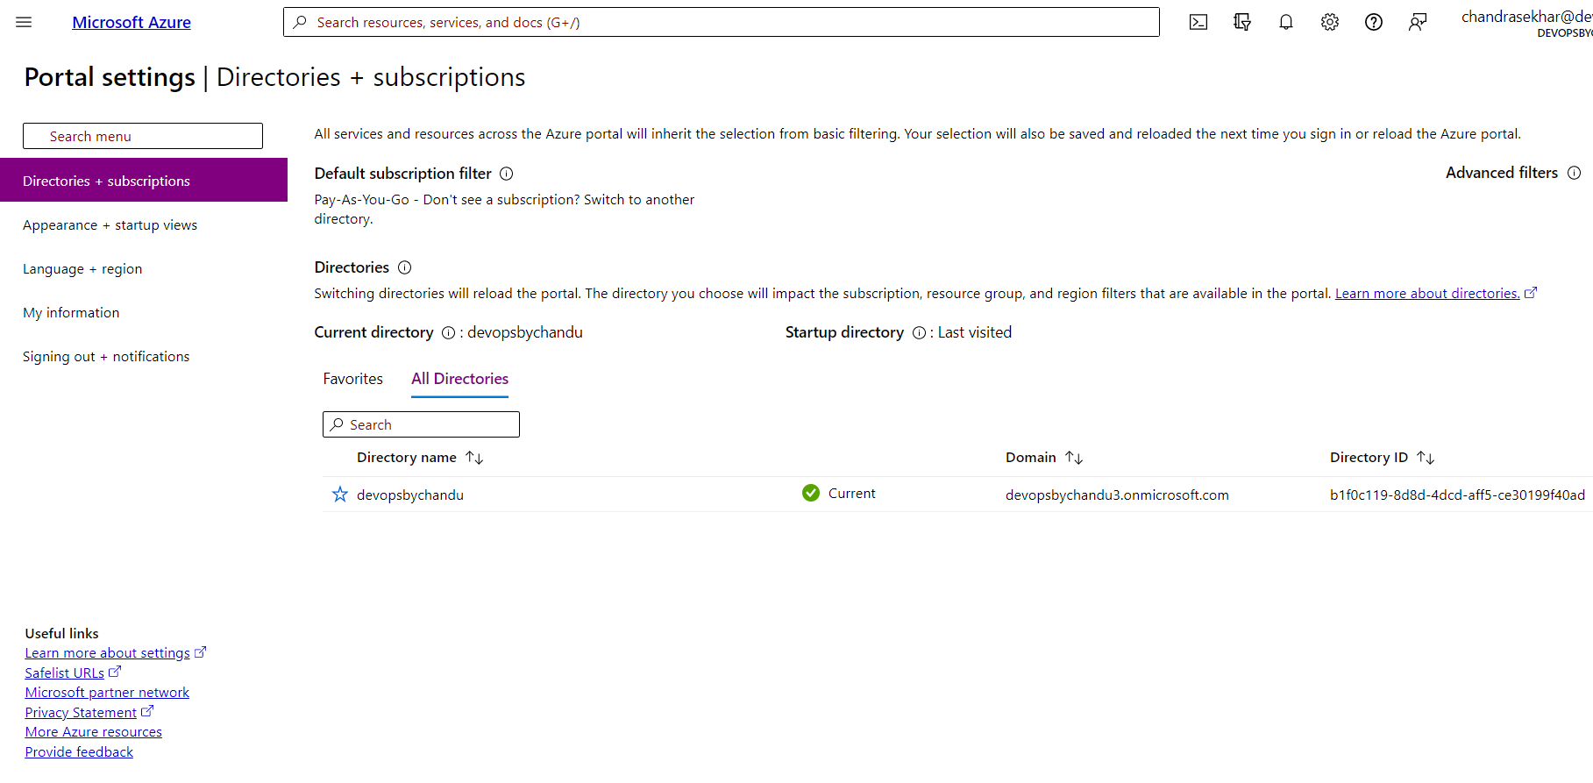
Directory + Subscription Filters and settings:
If your company has multiple subscriptions or multiple tenants we can filter them here.
We also can set up the appearance of the portal in this options.
By default your language is English. We can change the default language also here.
Also we can grab your information and change email can be possible.

Slide 6
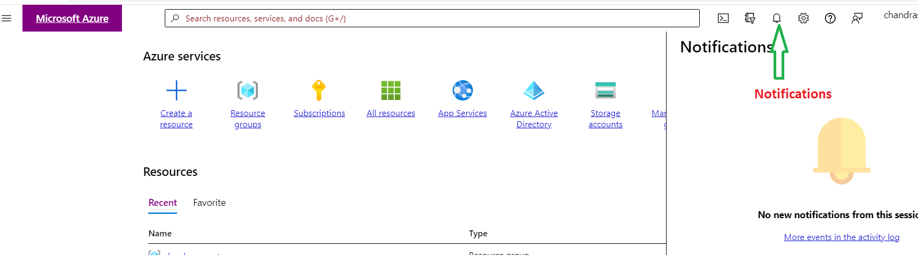
Notifications:
Any Resource you build or update or delete the cloud will notify you in the notification bar.
This is temporary place once you clear them we can’t see the notification here.
The command line execution scripts can not be notified in the cloud even those changing some of the properties of the resources

Slide 7
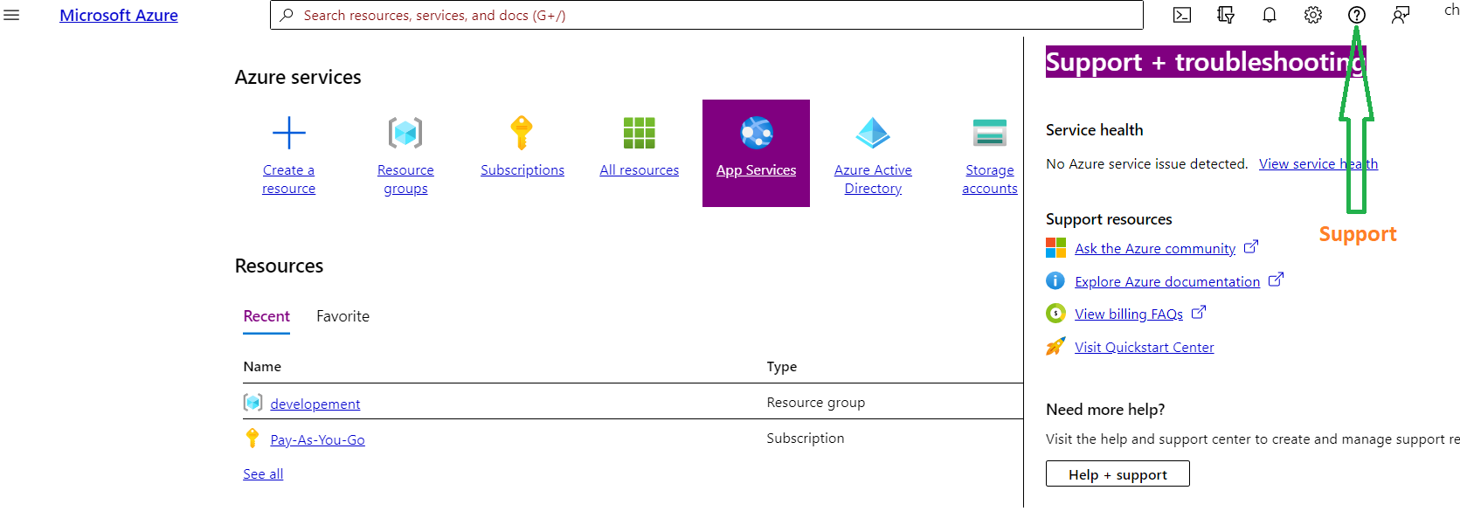
Support + troubleshooting:
If software companies need some assistance or facing issues on the existing resources, then they go to Microsoft with the support option.
Once we go we need to create a case number for seeking support from Microsoft.
There are 3 types of cases. Each one has their own SLA’s.
  Severity A: This has 24*7 access and rapid response will be 15 min.
  Severity B: This has Business hours will 24*7 access and rapid response will be 2 hours.
  Severity C: This has only Business hours access and rapid response will be 4 hours.
  Also we have plenty of documentation available for customer to work on their own.

Slide 8
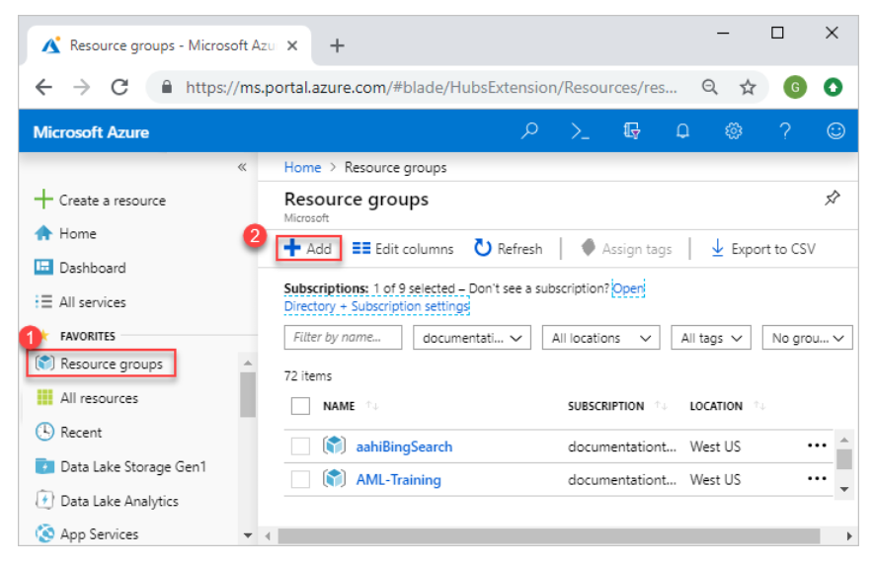
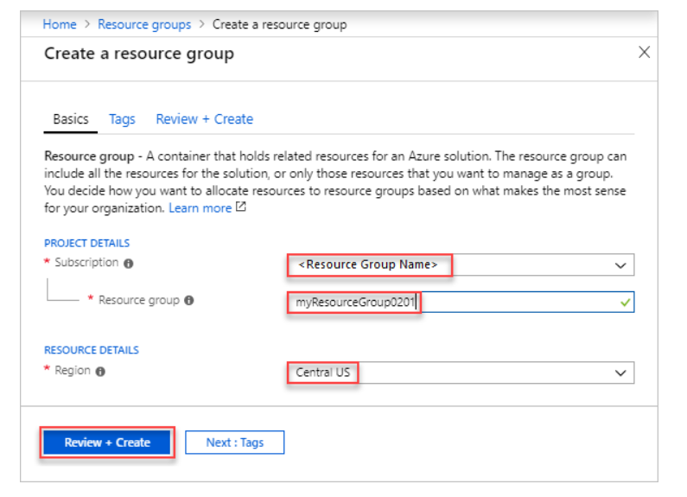
Resource Group:
A resource group is a container that holds related resources for an Azure solution.
he resource group can include all the resources for the solution, or only those resources that you want to manage as a group.
You decide how you want to allocate resources to resource groups based on what makes the most sense for your organization.
Create resource groups from portal:
Sign into azure portal.
Select Resource groups
Select Add
Enter the required info and create it.

Slide 9
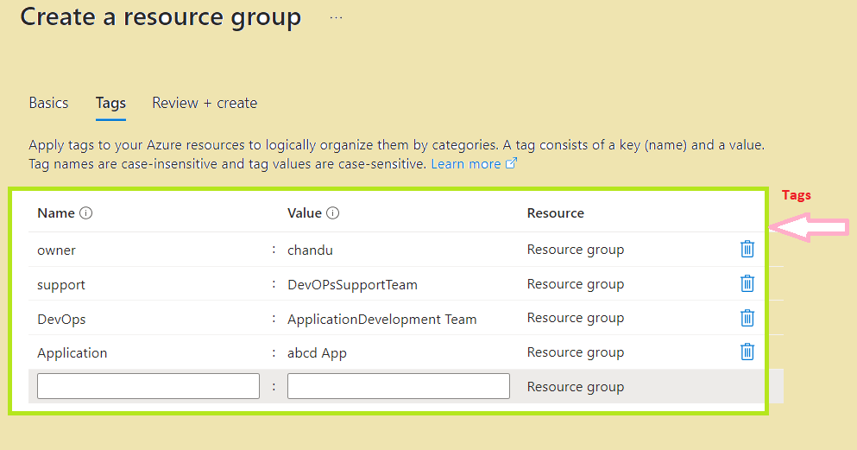
Tags:
Tags are metadata elements that you apply to your Azure resources.
They're key-value pairs that help you identify resources based on settings that are relevant to your organization.
This exactly can help a particular resource is belongs which team, who is support, who are developers and owners etc… based on the inputted info.
Tag names can't contain these characters: <, >, %, &, \, ?, /
Almost all resources Azure supports tags, but very few resources tags can not be supported. Below is the URL. Eg: Azure AD.
https://learn.microsoft.com/en-us/azure/azure-resource-manager/management/tag-support

Slide 10


Thank You! Happy Learning

